Slide 1

Cells
Detectors
DT3
DT2
Amplifier
DT1
SSC
Laser
FSC
Analog-to-digital converter

Slide 2
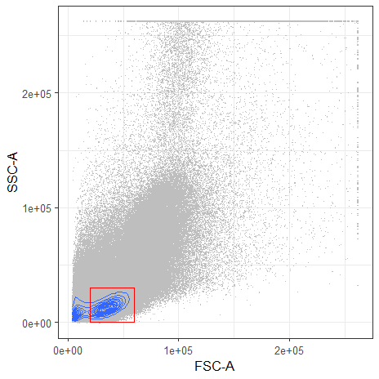
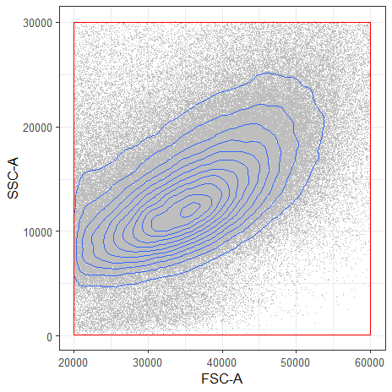
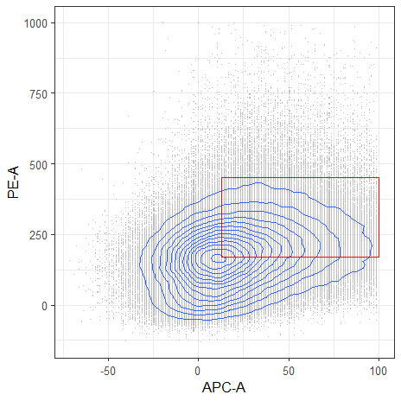
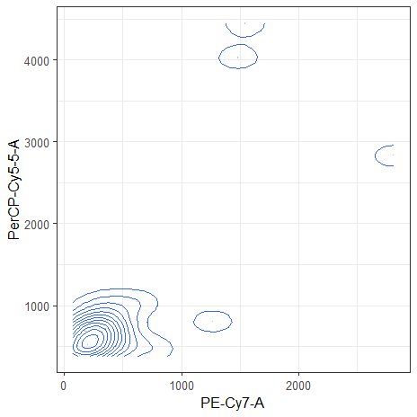
A
B
D
C

